Slide 1
Discrete Mathematics and Its Application 7th edition, 2001
Kenneth H. Rosen

Slide 2
Welcome to Discrete Mathematics Spring 2018
Instructor: Niu Shao Zhang

Slide 3
Chapter 3 Algorithms
Chapter Summary
Algorithms
Example Algorithms（实例算法）
Algorithmic Paradigms(算法范式)
Growth of Functions
Big-O and other Notation
Complexity of Algorithms

Slide 4
§3.1 Algorithms
Section Summary
Properties of Algorithms
Algorithms for Searching and Sorting
Greedy Algorithms（贪婪算法）
Halting Problem(停机问题)

Slide 5
Problems and Algorithms
In many domains there are key general problems that ask for output with specific properties when given valid input.
The first step is to precisely state the problem, using the appropriate structures to specify the input and the desired output.
We then solve the general problem by specifying the steps of a procedure that takes a valid input and produces the desired output. This procedure is called an algorithm.

Slide 6
§3.1 Algorithms
The foundation of computer programming.
Most generally, an algorithm just means a definite procedure for performing some sort of task.
A computer program is simply a description of an algorithm, in a language precise enough for a computer to understand, requiring only operations that the computer already knows how to do.
We say that a program implements (or “is an implementation of”) its algorithm.

Slide 7
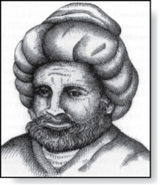
Algorithms
Abu Ja’far Mohammed Ibin Musa Al-Khowarizmi
(780-850)
Definition: An algorithm is a finite set of precise instructions for performing a computation or for solving a problem.
Example: Describe an algorithm for finding the maximum value in a finite sequence of integers.
(例如 求a₁, a₂, …., a_{n}中的最大数)
Solution: Perform the following steps:
Set the temporary maximum equal to the first integer in the sequence. （先让临时最大数= a₁ ）
Compare the next integer in the sequence to the temporary maximum.（比较a₁ 和a₂ ）
If it is larger than the temporary maximum, set the temporary maximum equal to this integer.（如果a₂> a₁,让a₂为临时最大数）
Repeat the previous step if there are more integers. If not, stop. （重复，让临时最大数与a₃…, 直到比较到a_{n} ）
When the algorithm terminates, the temporary maximum is the largest integer in the sequence. (最后得到的即最大数)

Slide 8
Specifying Algorithms（算法的描述）
Algorithms can be specified in different ways. Their steps can be described in English or in pseudocode.（伪代码）
Pseudocode is an intermediate step between an English language description of the steps and a coding of these steps using a programming language.
The form of pseudocode we use is specified in Appendix 3. It uses some of the structures found in popular languages such as C++ and Java.
Programmers can use the description of an algorithm in pseudocode to construct a program in a particular language.
Pseudocode helps us analyze the time required to solve a problem using an algorithm, independent of the actual programming language used to implement algorithm.

Slide 9
Properties of Algorithms
Input:（输入） An algorithm has input values from a specified set.
Output: （输出） From the input values, the algorithm produces the output values from a specified set. The output values are the solution.
Correctness: （真确性）An algorithm should produce the correct output values for each set of input values.
Finiteness:（有限性） An algorithm should produce the output after a finite number of steps for any input.
Effectiveness:（有效性） It must be possible to perform each step of the algorithm correctly and in a finite amount of time.
Generality: （通用性）The algorithm should work for all problems of the desired form.

Slide 10
Finding the Maximum Element in a Finite Sequence
The algorithm in pseudocode:
Does this algorithm have all the properties listed on the previous slide?
procedure max(a₁, a₂, …., a_{n}: integers)
max := a₁
for i := 2 to n
if max < a_{i} then max := a_{i}
return max{max is the largest element}

Slide 11
Some Example Algorithm Problems
Three classes of problems will be studied in this section.
Searching Problems（查找问题）: finding the position of a particular element in a list.
Sorting problems （排序问题） : putting the elements of a list into increasing order.
Optimization Problems （优化问题） : determining the optimal value (maximum or minimum) of a particular quantity over all possible inputs.

Slide 12
Searching Problems
Definition: The general searching problem is to locate an element x in the list of distinct elements a₁,a₂,...,a_{n}, or determine that it is not in the list.
The solution to a searching problem is the location of the term in the list that equals x (that is, i is the solution if x = a_{i}) or 0 if x is not in the list.
For example, a library might want to check to see if a patron is on a list of those with overdue books before allowing him/her to checkout another book.
We will study two different searching algorithms; linear search and binary search.

Slide 13
Linear Search Algorithm
The linear search algorithm locates an item in a list by examining elements in the sequence one at a time, starting at the beginning.
First compare x with a₁. If they are equal, return the position 1.
If not, try a₂. If x = a₂, return the position 2.
Keep going, and if no match is found when the entire list is scanned, return 0.
procedure linear search(x:integer,
a₁, a₂, …,a_{n}: distinct integers)
i := 1
while (i ≤ n and x ≠ a_{i})
i := i + 1
if i ≤ n then location := i
else location := 0
return location{location is the subscript of the term that equals x, or is 0 if x is not found}

Slide 14
顺序查找算法
在一个已知序列中找出与关键字相同的数的具体位置。
原理:让关键字与队列中的数从最后一个开始逐个比较，直到找出与给定关键字相同的数为止。
优点：简单直观，容易实现，它的缺点是效率低下。

Slide 15
Binary Search (二分查找)
Assume the input is a list of items in increasing order.
The algorithm begins by comparing the element to be found with the middle element.
If the middle element is lower, the search proceeds with the upper half of the list.
If it is not lower, the search proceeds with the lower half of the list (through the middle position).
Repeat this process until we have a list of size 1.
If the element we are looking for is equal to the element in the list, the position is returned.
Otherwise, 0 is returned to indicate that the element was not found.
In Section 3.3, we show that the binary search algorithm is much more efficient than linear search.

Slide 16
Binary Search
Example: The steps taken by a binary search for 19 in the list:
1 2 3 5 6 7 8 10 12 13 15 16 18 19 20 22
The list has 16 elements, so the midpoint is 8. The value in the 8th position is 10. Since 19 > 10, further search is restricted to positions 9 through 16.
1 2 3 5 6 7 8 10 12 13 15 16 18 19 20 22
The midpoint of the list (positions 9 through 16) is now the 12th position with a value of 16. Since 19 > 16, further search is restricted to the 13th position and above.
1 2 3 5 6 7 8 10 12 13 15 16 18 19 20 22
The midpoint of the current list is now the 14th position with a value of 19. Since 19 ≯ 19, further search is restricted to the portion from the 13th through the 14th positions .
1 2 3 5 6 7 8 10 12 13 15 16 18 19 20 22
The midpoint of the current list is now the 13th position with a value of 18. Since 19> 18, search is restricted to the portion from the 18th position through the 18th.
1 2 3 5 6 7 8 10 12 13 15 16 18 19 20 22
Now the list has a single element and the loop ends. Since 19=19, the location 16 is returned.

Slide 17
Binary Search
Here is a description of the binary search algorithm in pseudocode.
procedure binary search(x: integer, a₁,a₂,…, a_{n}: increasing integers)
i := 1 {i is the left endpoint of interval}
j := n {j is right endpoint of interval}
while i < j
m := ⌊(i + j)/2⌋
if x > a_{m} then i := m + 1
else j := m
if x = a_{i} then location := i
else location := 0
return location{location is the subscript i of the term a_{i} equal to x,
or 0 if x is not found}

Slide 18
二分查找的具体流程：
假设表中元素是按升序排列，将表中间位置记录的关键字与查找关键字比较
如果两者相等，则查找成功；否则利用中间位置记录将表分成前、后两个子表，如果中间位置记录的关键字大于查找关键字，则进一步查找前一子表，否则进一步查找后一子表。
重复以上过程，直到找到满足条件的记录，使查找成功，或直到子表不存在为止，此时查找不成功。

Slide 19
Sorting(排序)
To sort the elements of a list is to put them in increasing order (numerical order, alphabetic, and so on).
Sorting is an important problem because:
A nontrivial percentage of all computing resources are devoted to sorting different kinds of lists, especially applications involving large databases of information that need to be presented in a particular order (e.g., by customer, part number etc.).
An amazing number of fundamentally different algorithms have been invented for sorting. Their relative advantages and disadvantages have been studied extensively.
Sorting algorithms are useful to illustrate the basic notions of computer science.
A variety of sorting algorithms are studied in this book; binary, insertion, bubble, selection, merge, quick, and tournament.
In Section 3.3, we’ll study the amount of time required to sort a list using the sorting algorithms covered in this section.

Slide 20
Bubble Sort(冒泡排序)
Bubble sort makes multiple passes through a list. Every pair of elements that are found to be out of order are interchanged.
冒泡排序通过两层循环来排序。
双层循环的内层循环对所有相邻记录的关键字值进行两两比较，只要存在逆序就交换这两个元素。
每一遍排序即为双层循环的外层循环的一步，外层循环每进行一遍排序，就让最小的值交换到最前面，外层循环结束时即可达到有序化。

Slide 21
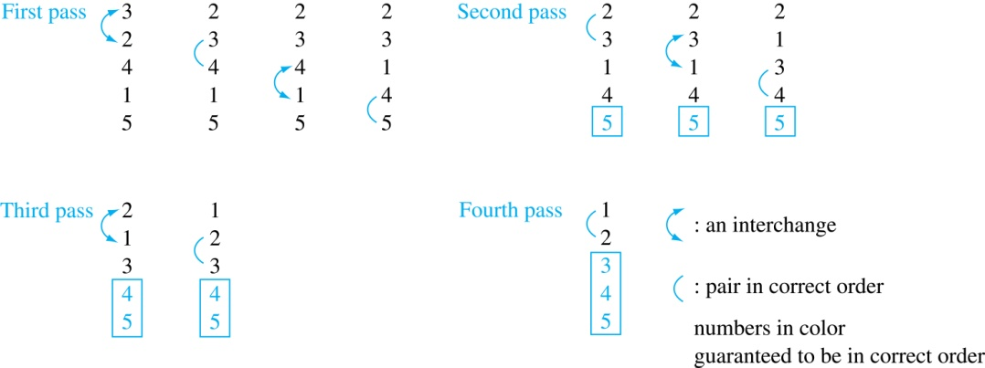
Bubble Sort
Example: Show the steps of bubble sort with 3 2 4 1 5
At the first pass the largest element has been put into the correct position
At the end of the second pass, the 2nd largest element has been put into the correct position.
In each subsequent pass, an additional element is put in the correct position.
（执行的遍数为排序的元素数-1）

Slide 22
Bubble Sort(冒泡排序)
Pseudocode
procedure bubblesort(a₁,…,a_{n}: real numbers
with n ≥ 2)
for i := 1 to n− 1
for j := 1 to n − i
if a_{j} >a_{j+1} then interchange a_{j} and a_{j+1}
{a₁,…, a_{n} is now in increasing order}

Slide 23
Insertion Sort(插入排序)
Insertion sort begins with the 2nd element. It compares the 2nd element with the 1st and puts it before the first if it is not larger.
Next the 3rd element is put into the correct position among the first 3 elements.
In each subsequent pass, the n+1st element is put into its correct position among the first n+1 elements.
Example: Show all the steps of insertion sort with the input: 3 2 4 1 5
2 3 4 1 5 (first two positions are interchanged)
2 3 4 1 5 (third element remains in its position)
1 2 3 4 5 (fourth is placed at beginning)
1 2 3 4 5 (fifth element remains in its position)

Slide 24
Insertion Sort
Example: Show all the steps of insertion sort with the input: 3 2 4 1 5
2 3 4 1 5 (first two positions are interchanged)
2 3 4 1 5 (third element remains in its position)
1 2 3 4 5 (fourth is placed at beginning)
1 2 3 4 5 (fifth element remains in its position)

Slide 25
Insertion Sort(插入排序)
Pseudocode
procedure insertion sort
(a₁,…,a_{n}:
real numbers with n ≥ 2)
for j := 2 to n
i := 1
while a_{j} > a_{i}
i := i + 1
m := a_{j}
for k := 0 to j − i − 1
a_{j-k} := a_{j-k-1}
a_{i} := m
{Now a₁,…,a_{n} is in increasing order}

Slide 26
Algorithm-Inventing Example(算法生成实例)
Suppose we ask you to write an algorithm to compute the predicate:
IsPrime:N→{T,F}
Computes whether a given natural number is a prime number.
First, start with a correct predicate-logic definition of the desired function:
∀n: IsPrime(n) ⬄ ¬∃1<d<n: d|n
Means d divides n evenly (without remainder)

Slide 27
Greedy Algorithms(贪婪算法)
Optimization problems minimize or maximize some parameter over all possible inputs.
Optimization problems can often be solved using a greedy algorithm, which makes the “best” choice at each step. Making the “best choice” at each step does not necessarily produce an optimal solution to the overall problem, but in many instances, it does.
After specifying what the “best choice” at each step is, we try to prove that this approach always produces an optimal solution, or find a counterexample to show that it does not.

Slide 28
Greedy Algorithms: Making Change
Example: Design a greedy algorithm for making change (in U.S. money) of n cents with the following coins: quarters (25 cents), dimes (10 cents), nickels (5 cents), and pennies (1 cent) , using the least total number of coins.
Idea: At each step choose the coin with the largest possible value that does not exceed the amount of change left.
If n = 67 cents, first choose a quarter leaving 67−25 = 42 cents. Then choose another quarter leaving 42 −25 = 17 cents
Then choose 1 dime, leaving 17 − 10 = 7 cents.
Choose 1 nickel, leaving 7 – 5 – 2 cents.
Choose a penny, leaving one cent. Choose another penny leaving 0 cents.

Slide 29
Greedy Change-Making Algorithm
Solution: Greedy change-making algorithm for n cents. The algorithm works with any coin denominations c₁, c₂, …,c_{r} .
For the example of U.S. currency, we may have quarters, dimes, nickels and pennies, with c₁ = 25, c₂ = 10, c₃ = 5, and c₄ = 1.
procedure change(c₁, c₂, …, c_{r}: values of coins, where c₁> c₂> … > c_{r} ; n: a positive integer)
for i := 1 to r
d_{i} := 0 [d_{i} counts the coins of denomination c_{i}]
while n ≥ c_{i}
d_{i} := d_{i} + 1 [add a coin of denomination c_{i}]
n = n - c_{i}
[d_{i} counts the coins c_{i}]

Slide 30
Proving Optimality for U.S. Coins
Show that the change making algorithm for U.S. coins is optimal.
Lemma 1: If n is a positive integer, then n cents in change using quarters (25 cents), dimes (10 cents), nickels (5 cents), and pennies (1 cent) , using the fewest coins possible has at most 2 dimes, 1 nickel, 4 pennies, and cannot have 2 dimes and a nickel. The total amount of change in dimes, nickels, and pennies must not exceed 24 cents.
Proof: By contradiction
If we had 3 dimes, we could replace them with a quarter and a nickel.
If we had 2 nickels, we could replace them with 1 dime.
If we had 5 pennies, we could replace them with a nickel.
If we had 2 dimes and 1 nickel, we could replace them with a quarter.
The allowable combinations, have a maximum value of 24 cents; 2 dimes and 4 pennies.

Slide 31
Proving Optimality for U.S. Coins
Theorem: The greedy change-making algorithm for U.S. coins produces change using the fewest coins possible.
Proof: By contradiction.
Assume there is a positive integer n such that change can be made for n cents using quarters, dimes, nickels, and pennies, with a fewer total number of coins than given by the algorithm.
Then, q̍ ≤ q where q̍ is the number of quarters used in this optimal way and q is the number of quarters in the greedy algorithm’s solution. But q̍ < q is not possible by Lemma 1.
Similarly, by Lemma 1, the two algorithms must have the same number of dimes, nickels, and quarters.

Slide 32
Greedy Change-Making Algorithm
Optimality depends on the denominations available.
For U.S. coins, optimality still holds if we add half dollar coins (50 cents) and dollar coins (100 cents).
But if we allow only quarters (25 cents), dimes (10 cents), and pennies (1 cent), the algorithm no longer produces the minimum number of coins.
Consider the example of 31 cents. The optimal number of coins is 4, i.e., 3 dimes and 1 penny. What does the algorithm output?

Slide 33
Greedy Scheduling
Example: We have a group of proposed talks with start and end times. Construct a greedy algorithm to schedule as many as possible in a lecture hall, under the following assumptions:
When a talk starts, it continues till the end.
No two talks can occur at the same time.
A talk can begin at the same time that another ends.
Once we have selected some of the talks, we cannot add a talk which is incompatible with those already selected because it overlaps at least one of these previously selected talks.
How should we make the “best choice” at each step of the algorithm? That is, which talk do we pick ?
The talk that starts earliest among those compatible with already chosen talks?
The talk that is shortest among those already compatible?
The talk that ends earliest among those compatible with already chosen talks?

Slide 34
Greedy Scheduling
Picking the shortest talk doesn’t work.
Can you find a counterexample here?
But picking the one that ends soonest does work. The algorithm is specified on the next page.
Start: 8:00 AM
Talk 1
Start: 9:00 AM
Talk 2
Start: 9:45 AM
End :9:45 AM
Talk 3
End: 10:00 AM
End: 11:00 AM

Slide 35
Greedy Scheduling algorithm
Solution: At each step, choose the talks with the earliest ending time among the talks compatible with those selected.
Will be proven correct by induction in Chapter 5.
procedure schedule(s₁ ≤ s₂ ≤ … ≤ s_{n} : start times, e₁ ≤ e₂ ≤ … ≤ e_{n} : end times)
sort talks by finish time and reorder so that e₁ ≤ e₂ ≤ … ≤ e_{n}
S := ∅
for j := 1 to n
if talk j is compatible with S then
S := S ∪ {talk j}
return S [ S is the set of talks scheduled]

Slide 36
Halting Problem （停机问题）
Example: Can we develop a procedure that takes as input a computer program along with its input and determines whether the program will eventually halt with that input.
Solution: Proof by contradiction.
Assume that there is such a procedure and call it H(P,I). The procedure H(P,I) takes as input a program P and the input I to P.
H outputs “halt” if it is the case that P will stop when run with input I.
Otherwise, H outputs “loops forever.”

Slide 37
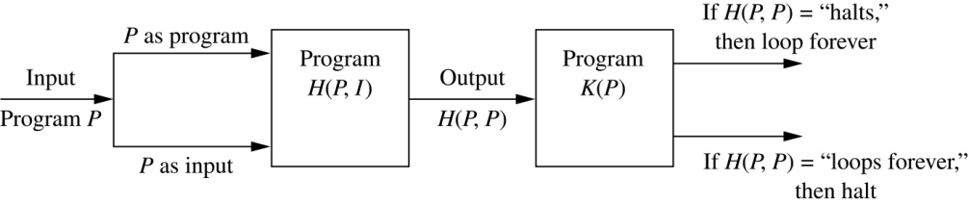
Halting Problem
Since a program is a string of characters, we can call H(P,P). Construct a procedure K(P), which works as follows.
If H(P,P) outputs “loops forever” then K(P) halts.
If H(P,P) outputs “halt” then K(P) goes into an infinite loop printing “ha” on each iteration.

Slide 38
Halting Problem
Now we call K with K as input, i.e. K(K).
If the output of H(K,K) is “loops forever” then K(K) halts. A Contradiction.
If the output of H(K,K) is “halts” then K(K) loops forever. A Contradiction.
Therefore, there can not be a procedure that can decide whether or not an arbitrary program halts. The halting problem is unsolvable.
(非严格证明)

Slide 39
Homework
§3.1
52

